Slide 1
Instructions
18010714 HYO JAE JEON
19012949 TASNAM A D M TANIM
20012763 ASAD AL AZIZ

Slide 2
Instructions
Computer’s language to command the computer hardware.
Vocabulary of Instructions are “Instruction Set”
Notes:
Instruction is computer’s language to command computer hardwares.
Vocabulary of Instructions are called Instruction Set.

Slide 3
Stored Program Concept
Designed by John von Neumann.
Running process
The executable file is loaded into RAM.
Among the instructions of the loaded executable file, the first-order instruction is fetched to the CPU.
The Fetch process proceeds through the import BUS (I/O BUS).
Commands are decoded (interpreted) by the Control Unit inside the CPU.
The interpreted commands are executed through ALU (Arithmetic Logic Unit).
Notes:
Stored Program Concept is designed by John von Neumann.
This is running process.
The executable file is loaded into RAM.
Among the instructions of the loaded executable file, the first-order instruction is fetched to the CPU.
The Fetch process proceeds through the import BUS (I/O BUS).
Commands are decoded (interpreted) by the Control Unit inside the CPU.
The interpreted commands are executed through ALU (Arithmetic Logic Unit).
We will show more about this in later.

Slide 4
Representing Instructions
 | OPcode | Memory Addressing Mode | Operand
Example | ADD | Register Mode | A, B, C
Meaning | Operation Code | Memory Addressing Mode | Address (Registers)
Notes:
This is Instruction set style.
The example of Instruction set is Addition of B, C, and store at A.
Op code of Instruction is operation code, in this example, ADD.
Memory Addressing Mode is about use memory address.
In this example, A, B, C is register, so it’s memory addressing mode is register mode.
Operand means Address of memory, or register.
Let’s start with op-code and operand.

Slide 5
OPcode / Operand
OPcode
Operation Code
Add, Sub, Load, Store …
Operand
“Address” of memory / Register
Notes:
An Instruction consists of an operation code, an addressing method, and an operand.
OP code is called operation code.
Example of op codes are add, substract, load, store.. and many other things.
Operand is address of memory, or register.
We can call data from operand, and operation with op-code.

Slide 6
Addressing modes
Implied Mode
Immediate Mode
Direct Addressing Mode
Indirect Addressing Mode
Register Mode
Register Indirect Mode
Relative Addressing Mode
Indexed Addressing Mode
Notes:
And about Memory Addressing mode.
There are 8 addressing modes exist.
Depending on the computer, it may be separately defined as above or defined in common with the operation method.
These are the addressing modes.
I will introduce modes start Implied Mode.

Slide 7
Implied Mode
Does not require an address field.
Implicit operand assignment.
Example
STORE X | Store AC into Memory[X].
MUL X | Multiply Memory[X] with AC, store at AC.
Notes:
Implied mode is Memory Address mode that does not requires an address field.
Operands are Implicit.
These are examples of Implied Mode Instructions.
STORE X is store accumulator value into memory address X.
MUL X is multiply, get value from memory address X, and then multply data with accumulator.
Then store at accumulator.

Slide 8
Immediate Mode
Specify the operand to actually use in the address field.
Example
LDI 100, R1 | Load and Initiate ‘100’ value into Register[R1].
Notes:
Implied mode is Memory Address mode that specify operands to actually use in the address field.
In example, this is load and Initiate Instruction.
It loads and Initiate ‘100’ value into R1, Register.

Slide 9
Direct Addressing Mode
Directly stores the address of the operand in the address field.
Advantage
Access to memory is done at once.
Disadvantage
The address space of the memory device that can be accessed is limited.
Example
LDA 600 | Load Memory[600] into AC.
Notes:
Direct Addressing Mode is Memory Address mode that directly stores ‘address’ at the operands in the address field.
Advantage of this method is accessing.
Computer can access to memory at one time, so it’s fast.
However, disadvantage of this method is limitation.
Address space of the memory can be accessed is limited.
This is example of Direct Addressing Mode.
LDA 600 is load memory address [600] into accumulator.

Slide 10
Indirect Addressing Mode
Stores the memory address where the effective address is stored in the address field.
Advantages
Accessible memory address space is determined by the length of words that the CPU can access at one time.
Disadvantage
Requires memory accesses two time.
Example
LDA [600] | Load Memory of [Memory[600]] into AC. If Memory[600] has ‘700’, than ‘LDA 700’
Notes:
Indirect Addressing Mode is Memory Address mode that stores memory address where effective address is stored in the address field.
Advantage of this method is length.
Computer can determine access memory address space by the length of words.
However, disadvantage of this method is time.
It requires memory accesses two time.
This is example of Indirect Addressing Mode.
LDA [600], similar as Direct Addressing Mode.
It’s load memory value of memory address 600 into accumulator.
If Memory address 600 has value ‘700’, than it means LDA 700.

Slide 11
Register Mode
Storing registers containing operands in address fields.
Therefore, the register number is stored in the operand field and there is no effective address.
Advantages
There are less operand fields.
Faster access to registers rather than memory.
Disadvantage
Since the number of registers is limited, it cannot be used indefinitely.
Example
LD R1 | Load Register 1 (R1) into AC.
Notes:
Register mode is use ‘registers’ to use data.
So we can use registers in the operands and don’t need to use effective address.
Advantages of register mode is shorter, faster use.
Operand is shorter than effective address modes, and its faster than memory address.
However, registers are limited, so we cannot use infinitly.
Example of register mode is LD R1.
It means Load register data (R1) into accumulator.
But,

Slide 12
Register Indirect Mode
Designating a register with the memory address value in which the operand is stored in the address field.
Therefore, in this method, the effective address is the address in the designated register.
Example
LDA (R1) | Load Register 1 (R1)’s Data as Memory Address into AC.
Notes:
Register mode has indirect mode too.
Register have address data inside, and if you call Instructions, then register calls address data inside the register.
Therefore, effective address is the address in the register.
Example of Register Indirect Mode.
It’s load register’s data as Memory address, and load it to accumulator.

Slide 13
Relative Addressing Mode
A method of adding the value of the instruction address field to the content of a specific register to calculate the effective address.
Certain registers mainly use PC (Program counter)
Effective address = instruction operand + PC
Advantage
Concise command configuration possible because it can be expressed with a small number of bits
Example
LDA $ADRS | AC ← M[ADRS + PC]
Notes:
Relative Addressing mode is quiet different.
It has calculation to get address of effective address.
We use Program counter for calculation.
The advantage of relative addressing mode is short to use it.
This is example of relative addressing mode.
Load address of memory, and add with program counter. And store calculation data at accumulator.

Slide 14
Indexed Addressing Mode
A method of adding the value of the instruction address field to the content of the index register to calculate the effective address.
Effective address = instruction operand + index register
Example
LDA ADRS(R1) | AC ← M[ADRS + R1]
Notes:
Last, Indexed Addressing mode.
Similar to Relative addressing mode, but it calls Register to calculate effective address.
Effective address can be instrurction operand plus index register.
Example of Indexed Addressing mode.
Get address of memory, and plus register value. And store at accumulator.

Slide 15
Signed / Unsigned Numbers
 | Range | Difference | Example
Signed Numbers |  | First Number can be used as sign. | 0000 0000 0000 0000 0000 0000 0000 0001 = 1 1000 0000 0000 0000 0000 0000 0000 0001 = -1
Unsigned Numbers |  | First Number can be used as figure. | 0000 0000 0000 0000 0000 0000 0000 0001 = 1 1000 0000 0000 0000 0000 0000 0000 0001 = 4294967297
$$-2^{31}∼2^{31}$$
$$0∼2^{32}$$
Notes:
This is binary numbers for calculate addresses.
What you've heard about signed and unsigned in C, JAVA, or any other high level language.
Use in assembly language, if you input decimal numbers, then it change into binary numbers.
Signed numbers can use in -2 square 31 to 2 square 31, left number can be used as sign. So Allows you to distinguish between negative and positive values.
However, unsigned numbers can use in 0 to 2 square 32. Left number can be used as figure, so allows you to use full size in positive values.

Slide 16
MIPS Assembly Language
Sample
“add a, b, c # The sum of (b) and (c) is placed in a.”
Means add (b), (c) and put their sum value in (a).
Sharp symbol (#) is comments for human reader.
Each line of this language can contain at most one instruction.
Comments always terminate at the end of a line.
Notes:
MIPS Assembly Language is low level language control computer hardwares.
This is sample of MIPS Assembly Language.
“add a, b, c”
It’s 3-address format assembly language.
It means add b and c snd put their sum value in (a) address.
Sharp Symbol is comments for human readers.
It’s just like \ in C, or # (Hashtag) in python.
Each line of this language can contain at most one instruction.
Comments always terminate at the end of a line.

Slide 17
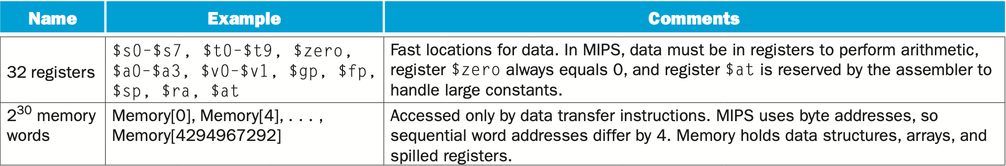
MIPS Operands
Notes:
There are two ways in MIPS Operands.
First one is register.
In MIPS, data must be in register to perform arithmetic Instructions like add, sub.
ZERO register always be 0, and $at register is reserved by assembler.
second one is memory words.

Slide 18
MIPS Assembly Language - Arithmetic
Notes:
This is arithmetic part of assembly language.
S1, S2, S3 is register operands, and we have to use in MIPS assembly language.
Add immediate is for using at add constants, and the table for add immediate in constants is 20.

Slide 19
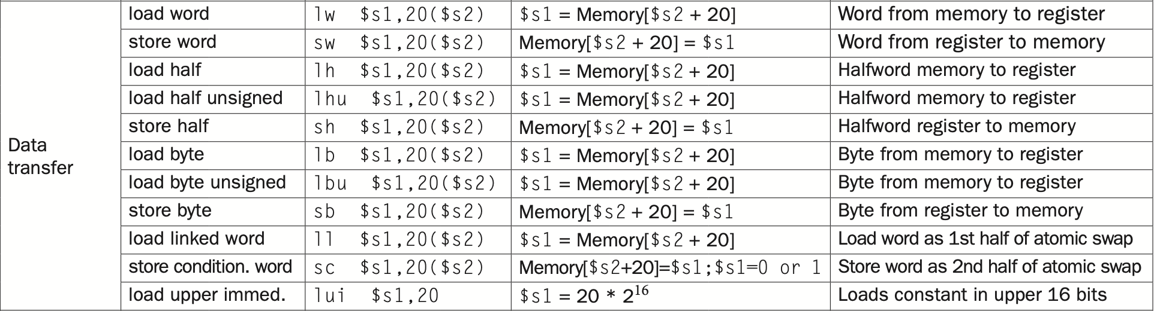
MIPS Assembly Language - Data Transfer
Notes:
This is data transfer instructions.
It can use memory address or registers.
Using unsigned methods can add ‘u’ in instructions, and you can use word, half, byte.

Slide 20
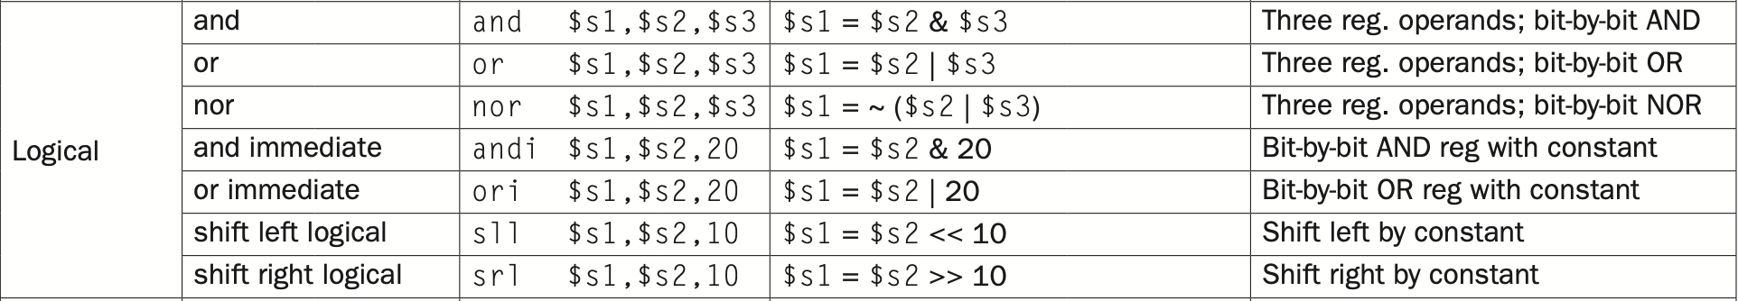
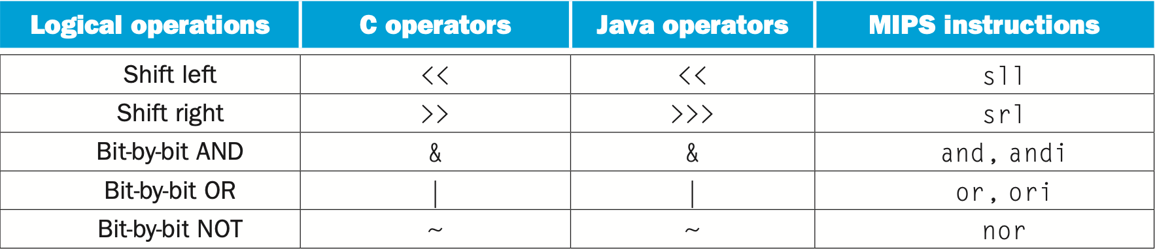
MIPS Assembly Language - Logical
Notes:
Logical Operations can call as shift.
They use in binary shifts.
Assembly use binary numbers to calculate, so it’s very useful.

Slide 21
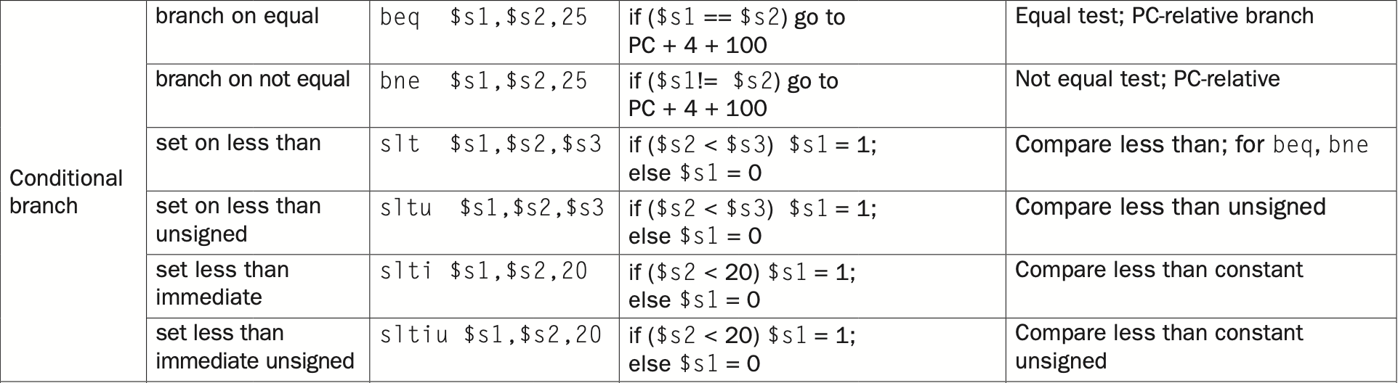
MIPS Assembly Language - Conditional Branch
Notes:
Conditional Branch can use in making decisions.
You can use branch as if, else, loop in like C language.

Slide 22
MIPS Assembly Language - Unconditional Jump
Notes:
This is jump method.
In c, you can use goto() functions to move lines, it’s same function as C.
It’s useful in functions, like sort function or using at loop section.

Slide 23
Synchronization
Parallel execution is easier when tasks are independent, but often they need to cooperate.
If they don’t synchronize, there is a danger of a data race, where the results of the program can change depending on how events happen to occur.
In computing, synchronization mechanisms are typically built with user-level software routines that rely on hardware-supplied synchronization instructions.

Slide 24
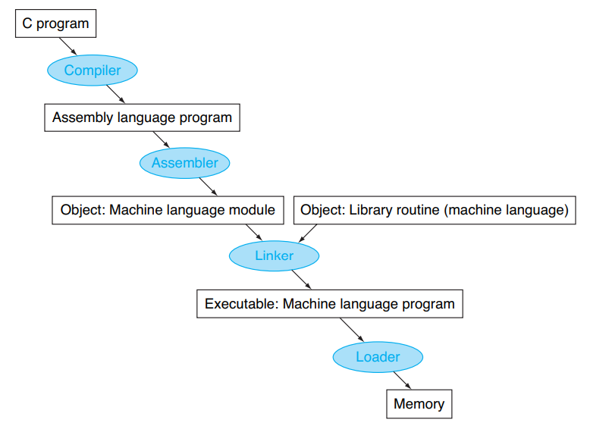
Translating and Starting Program
Elements
Compiler
Linker
Loader
Dynamically Linked Libraries(DLLs)

Slide 25
Compiler
A Compiler is primarily used for programs that translate source code from a high-level programming language to a machine level language to create an executable program.
Previously, many operating systems and assemblers were written in assembly language because memories were small, and compilers were inefficient.
Optimizing compilers today can produce assembly language programs nearly as good as an assembly language expert, and sometimes even better for large programs.

Slide 26
Assembler
An assembler is a program that takes basic computer instructions and converts them into a pattern of bits that the computer's processor can use to perform its basic operations. Some people call these instructions assembler language and others use the term assembly language.
Assembler in assembly language simplifies the translation and programming.
Common variations of machine language instructions, which assemblers can use as their own is called pseudoinstructions.
pseudoinstructions give MIPS a richer set of assembly language instructions than those implemented by the hardware.

Slide 27
Assembler
Assemblers keep track of labels used in branches and data transfer instructions in a symbol table. As you might expect, the table contains pairs of symbols and addresses.
Symbol table A table that matches names of labels to the addresses of the memory words that instructions occupy.
The table contains pairs of symbols and addresses

Slide 28
Assembler
The object file for UNIX systems typically contains six distinct pieces:
The object file header describes the size and position of the other pieces of the object file.
The text segment contains the machine language code.
The static data segment contains data allocated for the life of the program.
The relocation information identifies instructions and data words that depend on absolute addresses when the program is loaded into memory.
The symbol table contains the remaining labels that are not defined, such as external references.
The debugging information contains a concise description of how the modules were compiled so that a debugger can associate machine instructions with C source files and make data structures readable.

Slide 29
Linker
A systems program that combines independently assembled machine language programs and resolves all undefined labels into an executable file.
There are three steps for the linker:
Place code and data modules symbolically in memory.
Determine the addresses of data and instruction labels.
Patch both the internal and external references.
The linker produce an executable file which has a similar format type as an object file

Slide 30
Loader
A systems program that places an object program in main memory so that it is ready to execute.
The loader follows these steps in UNIX systems:
Reads the executable file header to determine size of the text and data segments.
Creates an address space large enough for the text and data.
Copies the instructions and data from the executable file into memory.
Copies the parameters (if any) to the main program onto the stack.
Initializes the machine registers and sets the stack pointer to the first free location.
Jumps to a start-up routine that copies the parameters into the argument registers and calls the main routine of the program. When the main routine returns, the start-up routine terminates the program with an exit system call.

Slide 31
DLL
Dynamically Linked Libraries (DLLs) Library routines that are linked to a program during execution.
In the initial version of DLLs, the loader ran a dynamic linker, using the extra information in the file to find the appropriate libraries and to update all external references.
The lazy procedure linkage version of DLLs, where each routine is linked only after it is called.

Slide 32
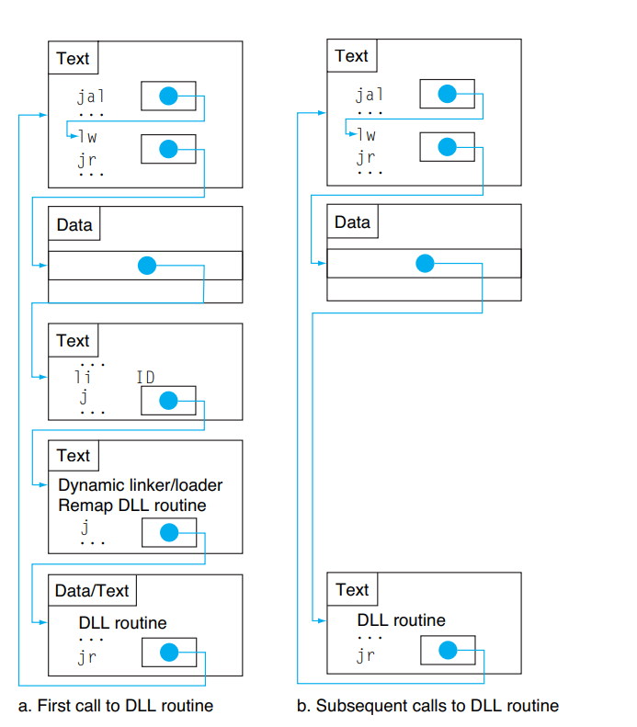
DLL

Slide 33
Starting a JAVA Program
Java was invented with a different set of goals. One was to run safely on any computer, even if it might slow execution time.
Rather than compile to the assembly language of a target computer, Java is compiled first to instructions that are easy to interpret: the Java bytecode instruction set.
Like the C compiler, the Java compiler checks the types of data and produces the proper operation for each type.

Slide 34
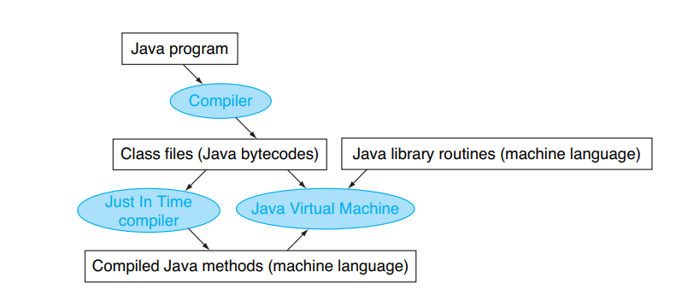
Start a JAVA Program

Slide 35
Advantages
Ease of writing an interpreter
Better error messages
Smaller object code
Machine independence

Slide 36
Array VS Pointer
Example
clear1(int array[], int size) { int i; for (i = 0; i < size; i += 1) array[i] = 0; } clear2(int *array, int size) { int *p; for (p = &array[0]; p < &array[size]; p = p + 1) *p = 0; }
Clear1 uses array, while clear2 uses pointers.

Slide 37
JAVA and C
People used to be taught to use pointers in C to get greater efficiency than that available with arrays: “Use pointers, even if you can’t understand the code.”
Modern optimizing compilers can produce code for the array version that is just as good.
Most programmers today prefer that the compiler do the heavy lifting.

Slide 38
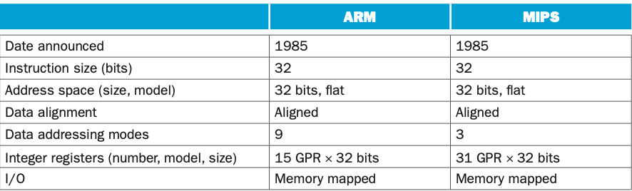
ARM processor
Notes:
ARM is the most popular instruction set architecture for embedded devices, like smartphones.
ARM is Advanced RISC Machine, ARM came out the same year as MIPS and followed similar philosophies.
The principle difference is that MIPS has more registers and ARM has more addressing modes.
There is a similar core of instruction sets for arithmetic-logical and data transfer instructions for MIPS and ARM.

Slide 39
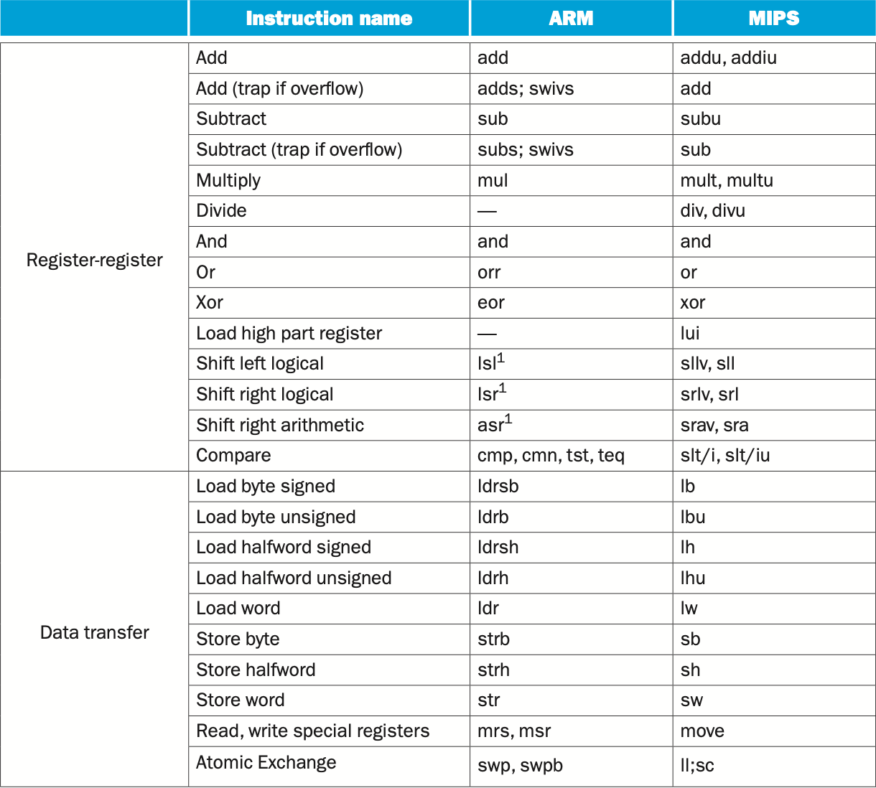
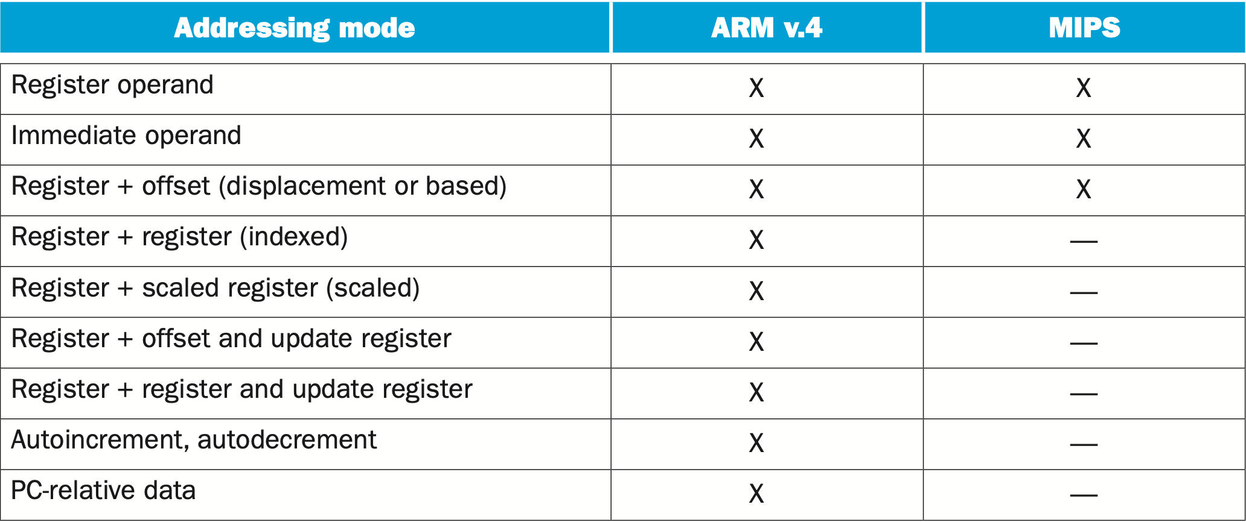
Instructions in ARM processor
Notes:
These are ARM Processors instructions.
Quite similar with MIPS processor instructions.
Unlike MIPS, ARM doesn’t have $zero reserved registers.
And Memory addressing modes in ARM has 9, and MIPS addressing modes are 3.
These are addressing mode that supports arm and mips.
ARM has separate register indirect and register + offset addressing modes, rather than just putting 0 in the offset of the latter mode. To get greater addressing range, ARM shifts the offset left 1 or 2 bits if the data size is halfword or word.

Slide 40
Stored Program Computer Principles
Fallacy: More powerful instructions mean higher performance.
Fallacy: Write in assembly language to obtain the highest performance.
Fallacy: The importance of commercial binary compatibility means successful instruction sets don’t change.
Pitfall: Forgetting that sequential word addresses in machines with byte addressing do not differ by one.
Pitfall: Using a pointer to an automatic variable outside its defining procedure.
Notes:
Stored Program Computer designing has fallacy and pitfalls.
Fallacies for designing stored program computers, first one is ‘More powerful instructions mean higher performance.’
However, powerful instructions tend to be complex and difficult to execute in hardware. This penalizes all commands.
Second one is ‘write in assembly language to obtain the highest performance’
In the old days, it was true.
Because back then, there was no guarantee that compilers would produce fast code.
But modern compilers know what code to generate for modern processors.
Third one is ‘The importance of commercial binary compatibility means successful instruction sets don’t change.’
However, new commands are slowly emerging. That said, the x86, ARM instruction set is getting bigger and bigger.
It's nice to have backwards compatibility, but you have to put up with a huge instruction set.
Pitfalls have two.
Forgetting that sequential word addresses in machines with byte addressing do not differ by one.
It’s an error that find the address of the word by passing the address of the register one more space.
Using a pointer to an automatic variable outside its defining procedure.
Pointers to automatic variables can lead to chaos.

Slide 41
Design Principles
Simplicity favors regularity.
Smaller is faster.
Make the common case fast
Good design demands good compromises.
Notes:
Away from pitfalls and fallacy, we should think about design principles.
These are four design principles for architecture.
Simplicity favors regularity, smaller size of design will be faster, make the common cases fast, good design demands good compromises.

Slide 42
Source
COMPUTER ORGANIZATION AND DESIGN (4th Edition) David A. Patterson, John L. Hennessy

